Slide 1




Craft Beer and Brewery Case Study
DS 6306 – Project One
Jason Burk

Slide 2
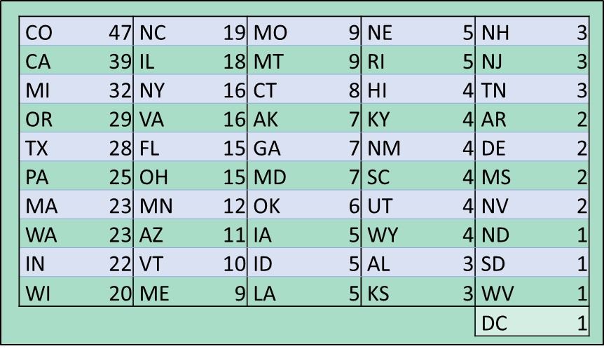
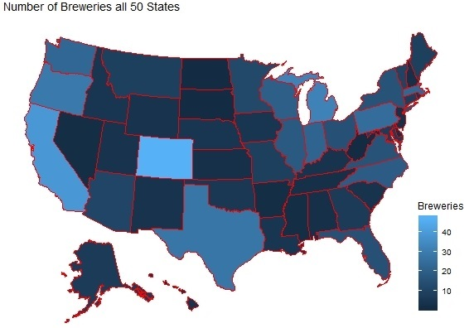
Number of Micro-Breweries by State
Notes:
Question 1

Slide 3
Data Files Contained Missing Data
Using a function called “MICE” or Multivariate Imputation by Chained Equations we were able to infer values for Alcohol by Volume (ABV) and International Bitterness Units (IBU) where missing.
The MICE algorithm imputes an incomplete column (the target column) by generating 'plausible' synthetic values given other columns in the data.
Notes:
Question 3

Slide 4
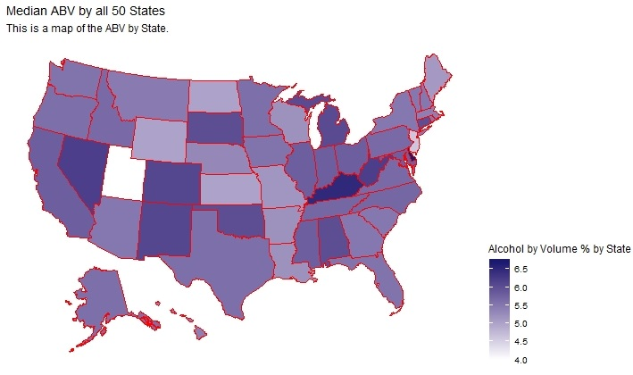
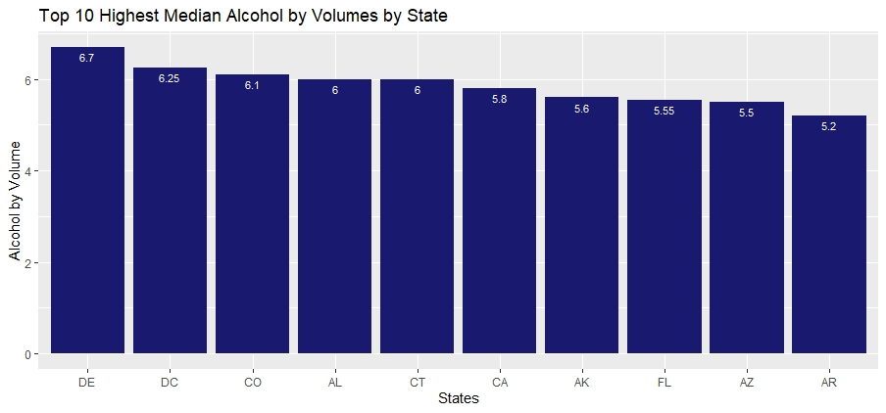
Median Alcohol Content (ABV) by State
Bud ABV: 5%
Notes:
Question 4

Slide 5
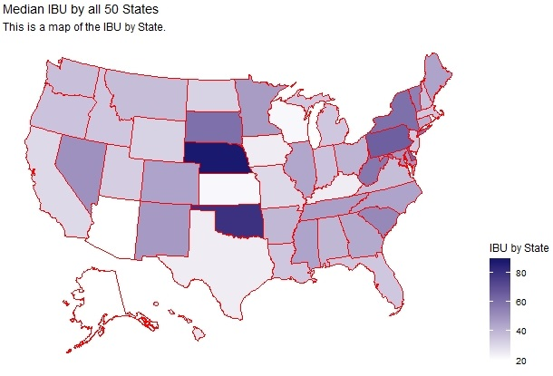
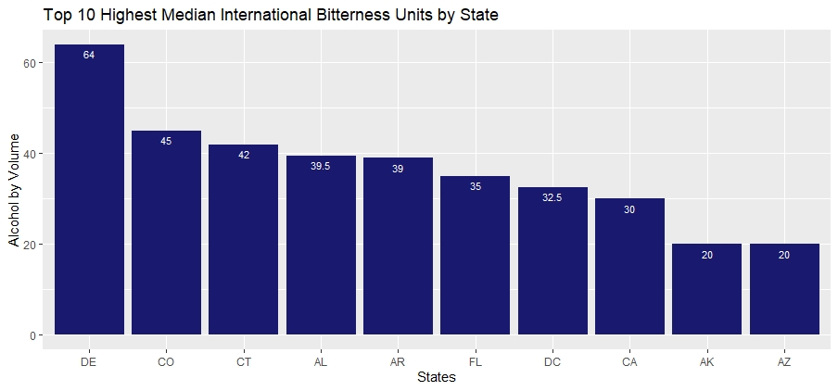
Median International Bitterness Units (IBU) by State
Bud IBU: 7
Notes:
Question 4

Slide 6
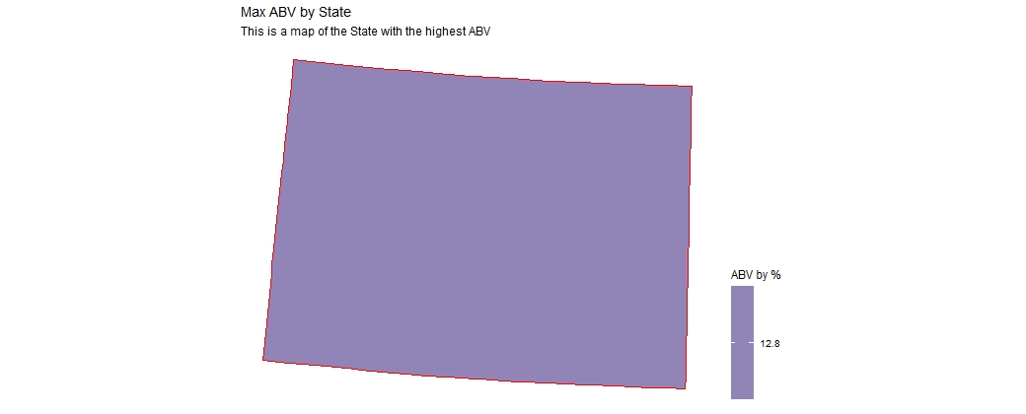

Maximum ABV and IBU by State COLORADO
ABV Max
IBU Max
12.8%
138
Notes:
Question 5

Slide 7
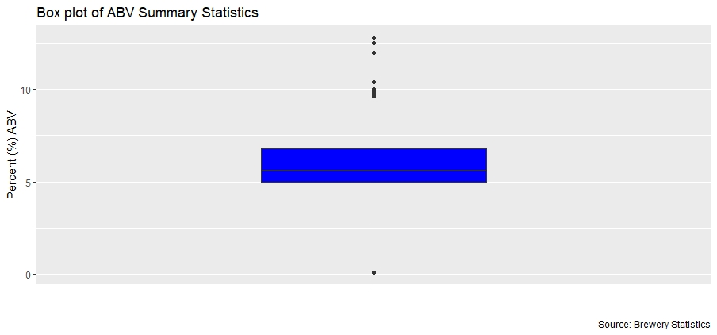
ABV Summary Statistics
Max | 12.8%
3rd Qtr | 6.8%
Mean | 5.9%
Median | 5.6%
1st Qtr | 5.0%
Min | 0.1%
Notes:
Question 6

Slide 8
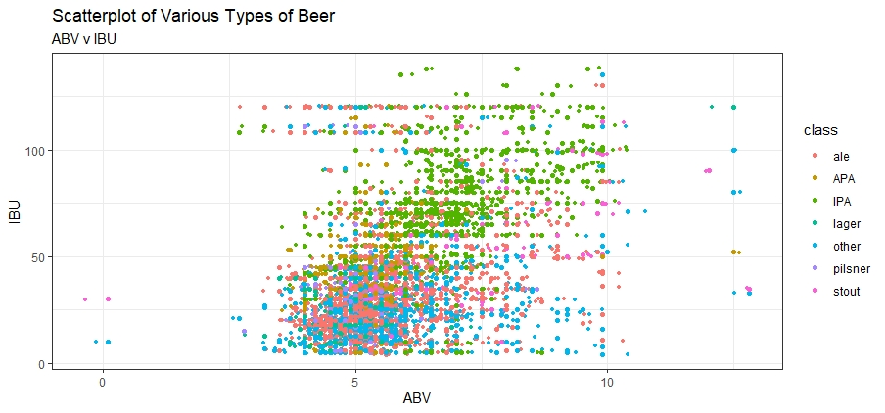
Alcohol By Volume and International Bitterness Units Relationship
Notes:
Question #7

Slide 9
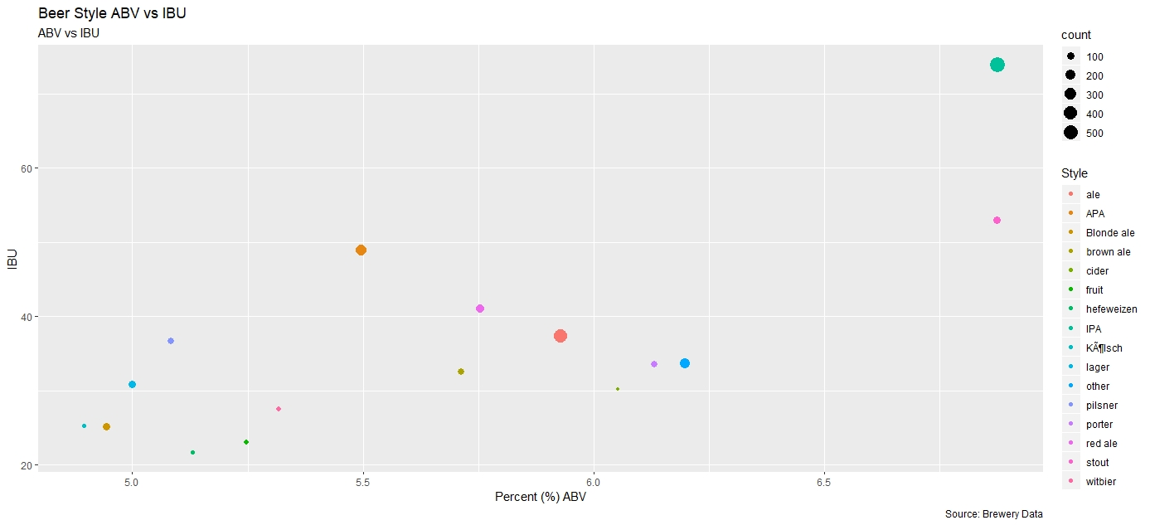
Alcohol By Volume and International Bitterness Units by Style

Slide 10
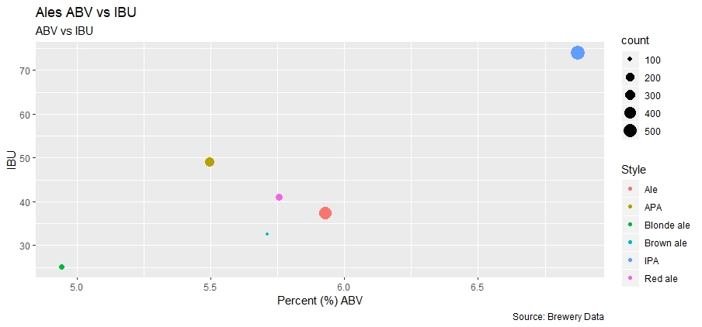
ABV and IBU: IPA and all other Ales

Slide 11
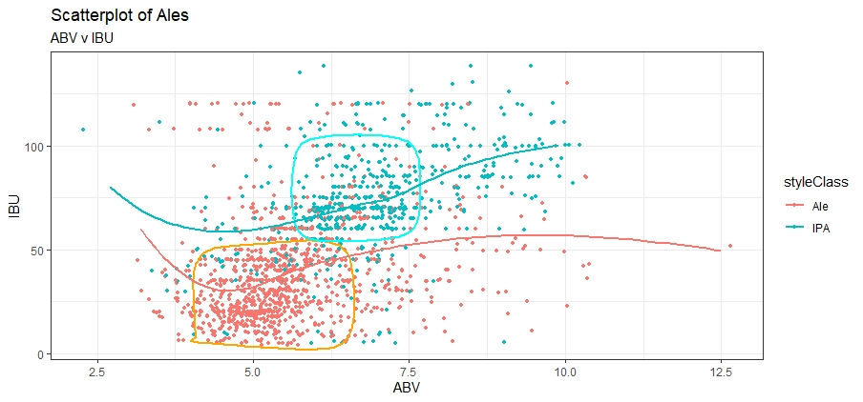
Scatterplot of Ales and IPAs

Slide 12
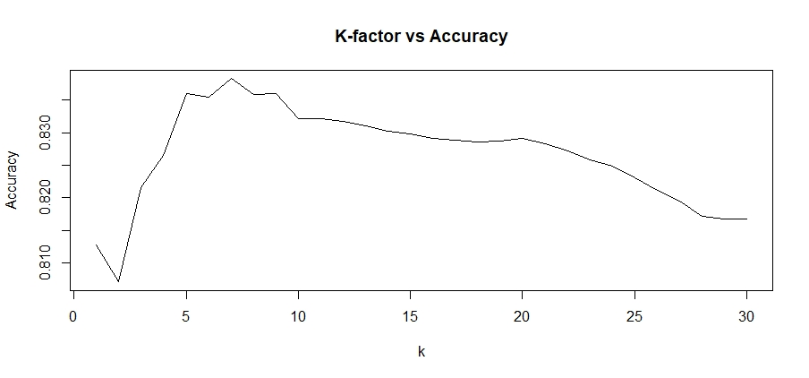
Classification Using K Nearest Neighbors (k-nn)
Optimal k = 7
Notes:
80/20 sample size
KNN is an algorithm that uses previous data classification values points to predict the classification of new sample values

Slide 13
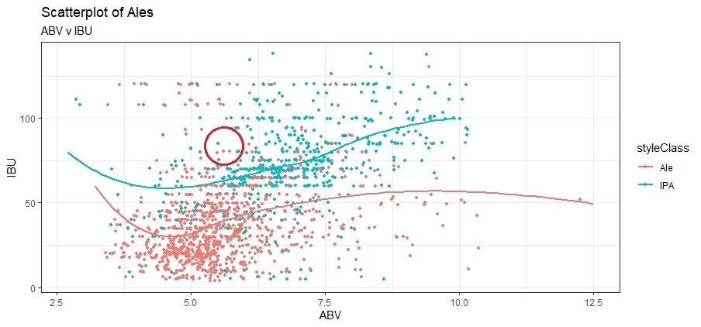
k-nn = 7
Ale | 3
IPA | 4

Slide 14
k-nn Confusion Matrix
 | Ale | IPA
Ale | 184 | 19
IPA | 29 | 84
Accuracy | 84.8 %
Sensitivity | 86.4 %
Specificity | 81.6 %

Slide 15
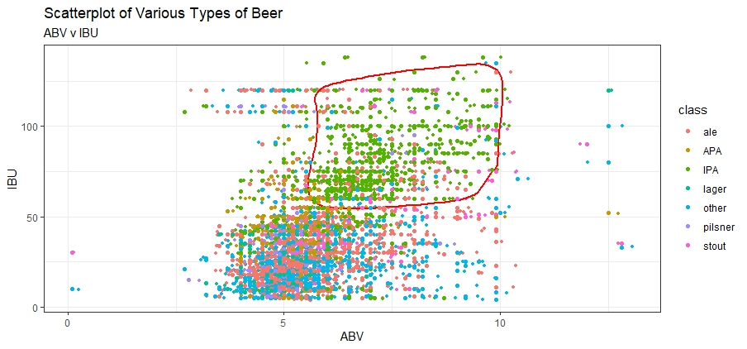
IPA’s are “In”
Style | # | %
IPA | 571 | 23.7
“Ale” | 420 | 17.4
APA | 245 | 10.2
Other | 234 | 9.7
Red Ale | 146 | 6.1
Blonde Ale | 108 | 4.5
Stout | 100 | 4.1
Pilsner | 91 | 3.8
Total Sample Size = 2410

Slide 16
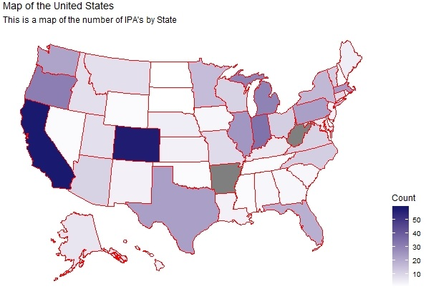
IPA’s by US Map
State | IPA’s
California | 58
Colorado | 57
Indiana | 34
Oregon | 31
Michigan | 30
Illinois | 25
Massachusetts | 24

Slide 17
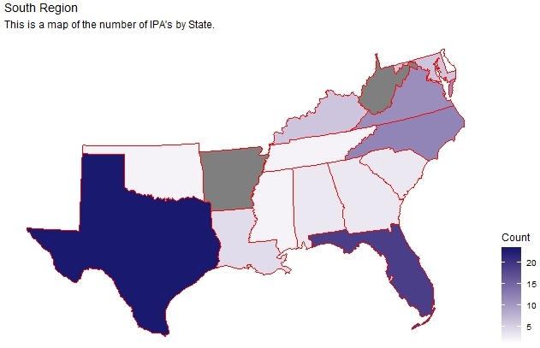
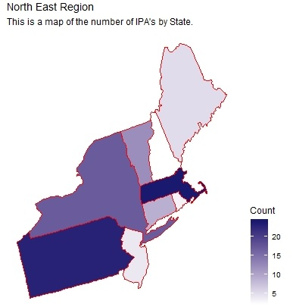
IPA’s in the East

Slide 18
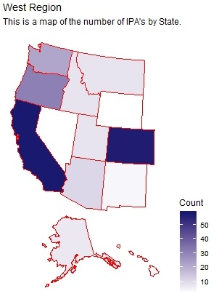
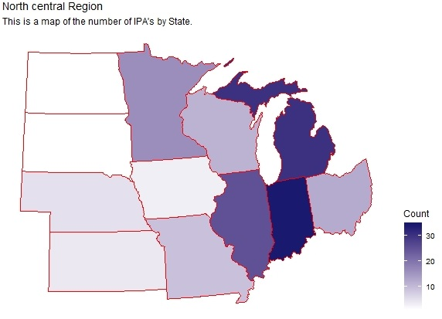
IPA’s in the Midwest and Western US

Slide 19
Recommendation

Slide 20
Thank you
Notes:
Thank you

